Slide 1

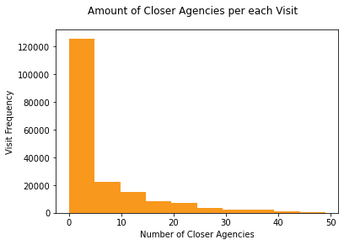
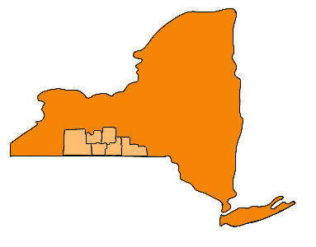
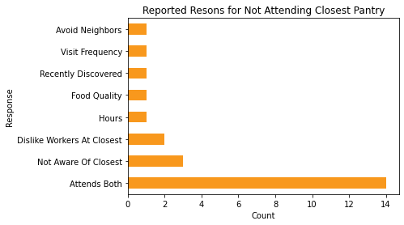
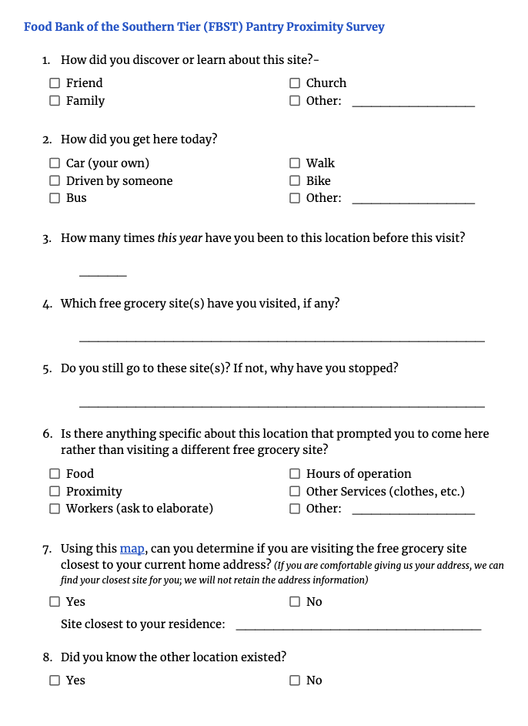
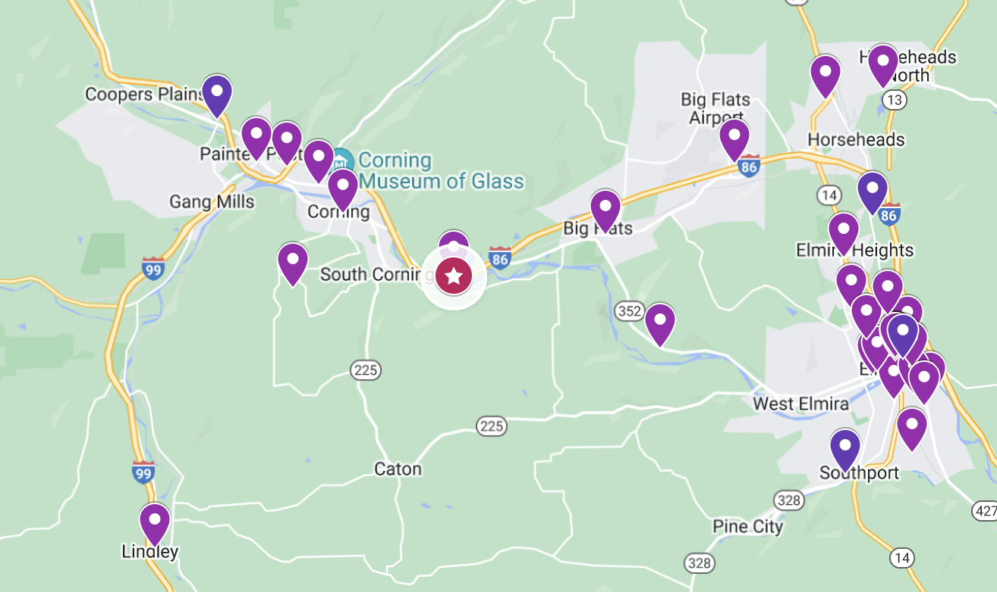
What makes food pantries worth the distance?
Medha Bulumulla, Christopher B. Barrett, Kelsey Schreiber, John Hoddinott
Cornell University, College of Agriculture and Life Sciences
INTRODUCTION
METHODS
RESULTS
Abstract
Food pantries play a vital role in supporting the diets of food insecure people in the United States. Yet only 36.5% of food-insecure households utilize food pantries (USDA ERS - Food Pantries). We use administrative data from the Food Bank of the Southern Tier (FBST), which serves 167 member food pantries in six upstate New York counties, to examine spatial patterns of households’ food pantry use. The FBST data are matched with richer administrative data on public Supplemental Nutrition Assistance Program (SNAP) redemption and combined with administrative data on pantry attributes. This data is used to test which attributes of pantries reveal the differences between those who do not access (i) any food pantry or (ii) the most proximate food pantry(ies) to their residence. Merged FBST and SNAP administrative data contain information on households (household size, residence location, age of household held, household income, pantry attendance location(s), pantry use frequency etc) receiving SNAP information benefit(s), and FBST pantry information (location, service type, site type, and religious affiliation (if any)). Clients (n= 29890) are willing to travel further for full-time pantry, with the ability to choose select food, and receive a three-day food supply. Older household heads are more likely to travel further distances to a pantry with a 3.76 year average gap between those participating in non-proximate and proximate visits. On-site interviews of four pantries of the largest frequency and percentage of non-proximate visits to investigate resource-limited households’ choice around food pantry use. About half of survey respondents (n = 49) reported they were not attending their closest pantry during the visits. More than half of these clients, or 29% of the entire sample, attend their closest pantry on a regular basis in addition to the pantry they were at, revealing that one visit or pantry is not enough to sustain their needs. Poor experiences with workers and food quality have deterred clients from visiting their closest option.
Literature
As of March 2023, the Emergency Allotment (EA) of Supplemental Nutritional Assistance Program (SNAP) will end, causing a reduction in the federal benefits some food-insecure households receive to purchase food. Food pantries are serving more people than ever following the pandemic. (Morello, 2021).
Food pantries provide free and low-requirement sources of food for food-insecure families. Many cited barriers exist to food pantry use including social stigma, poor information on pantry systems, eligibility, mis-alignment of self-identity, hours of operation, and transportation (Daponte, 2000; El Zein et. al, 2018).
In Alleghany, PA, an urban area, car ownership was more significant in predicting pantry use compared to all other variables (household structure, age, education, race). (Daponte et al., 1998)
In four rural counties, clients were surveyed on the interplay of chronic diseases, specifically diabetes, and food insecurity. All clients preferred choice in pantries with an inclination towards fresh produce, dairy products, protein and variety. Those with chronic conditions were more frustrated when client choice was not present and households with diabetes individuals preferring low-carbohydrate and low-sodium foods. (Remley et al., 2019)
Mixing qualitative and quantitative data components creates powerful and well-rounded results. Combining administrative data over a 10-year period and qualitative interviews created in tandem (not linked to the administrative data) found key insights that could not have been gained with just quantitative analysis. In measuring food insecurity, they found ½ of the women were classified as food secure by US Department of Agriculture’s Household Food Security Scale (HFSS) but interviews exposed numerous coping strategies including food stamps, buying lower quality items (day-old bread, reduced-price meats), borrowing money or food and budgeting (Carlson et al., 1999) Through interviews they also discovered the pride women feel that they can feed their children but it can be at the expense of other costs including rent, utilities and other bills. (London et al., 2007)
Distance Calculations
The Euclidean distance between household’s residence and all pantries are calculated. The distance between the visited pantry and attended pantry are recorded.
There is a statistically significant difference (p = 5.8e-106) between urban and rural environments on the distance travelled.
Instead of only focusing on distance, visits are categorized by the number of closer pantries to the household’s residence than the attended pantry. Most visits feature household’s attending their closest pantry with the closer agencies metric heavily skewed as shown in Figure 2.
As Euclidean distance underestimates road distance, we opt for classifying each entry as a non-proximate or proximate visit (Shahid et al., 2009) A non-proximate visit is categorized as a pantry visit in which there were 6 or more closer pantries. 6 is the third quartile point of the closer agency distribution
Examining the quantitative differences between non-proximate (29,621) and proximate visits (98,668).
 | Proximate n = 98, 668 | Not Proximate n = 29, 621 | Proximate Percent | Not Proximate Percent | Percent Difference
Located in Full-time Pantry | 3,561 | 10,438 | 4.11 | 25.17 | 21.06
Ability to Choose Food | 65,734 | 38,339 | 75.95 | 92.42 | 16.47
Pantry in Urban Location | 32,411 | 21,587 | 37.45 | 52.06 | 14.61
Urban Residence | 32,489 | 21,090 | 37.54 | 50.84 | 13.3
Located outside Apartment | 14,428 | 2167 | 16.67 | 5.22 | 11.45
Food for 3 days | 31,463 | 19,703 | 36.35 | 47.49 | 11.14
First Visit for Family | 19,080 | 12,944 | 22.04 | 31.2 | 9.16
Mobile Food Pantry | 53,681 | 22,021 | 62.03 | 53.09 | 8.94
Located in Church | 46,257 | 19,832 | 53.45 | 47.81 | 5.64
Located outside Senior Center | 4,330 | 232 | 5 | 0.56 | 4.44
Located in Community Building | 4,565 | 3,037 | 5.27 | 7.32 | 2.05
Receives SNAP Benefits | 43,691 | 21,443 | 50.48 | 51.69 | 1.21
Female Household Head | 57,323 | 27,859 | 66.24 | 67.15 | 0.91
Prepacked Food | 36 | 54 | 0.04 | 0.13 | 0.09
Male Household Head | 27,009 | 12,915 | 31.21 | 31.13 | 0.08
Data
Figure 2: Number of Closer Pantries per Visit
29, 890 families and 128,029 pantry visits are examined
Binary Variables
Male Household Head
Female Household Head
Receives SNAP Benefits
First Visit for Family
Urban Residence
Ability to Choose Food
Prepacked Food
Food for 3 days
Mobile Food Pantry
Located in Church
Located outside Apartment
Located outside Senior Center
Located in Community Building
Located in Full-time Pantry
Pantry in Urban Location
Numerical Variables
Age of Household Head
Number of Adults
Number of Children
Number of Seniors
Family Size
Attended Pantry & Residence Distance
 | Proximate Mean n= 86,544 | Proximate Standard Deviation | Not Proximate Mean n = 41,485 | Not Proximate Standard Deviation | Difference Mean | P-value
Distance between Attended Pantry & Residence | 4.2 | 5.88 | 25.02 | 54.56 | 20.82 | -
Age of Household Head | 59.69 | 17.39 | 55.93 | 16.22 | 3.76 | 6.30E-298
Distance between Closest Pantry & Residence | 3.08 | 4.78 | 4.42 | 30.31 | 1.34 | -
Family Size | 2.23 | 1.72 | 2.81 | 1.97 | 0.58 | 0.00E+00
Number of Adults | 1.74 | 1.01 | 2.04 | 1.19 | 0.3 | 0.00E+00
Number of Children | 0.52 | 1.14 | 0.76 | 1.29 | 0.24 | 1.10E-255
Number of Seniors | 0.73 | 0.74 | 0.62 | 0.74 | 0.11 | 1.39E-129
A variety of factors derived from administrative data on households, pantries and SNAP benefits are examined to quantify the difference between proximate and non-proximate pantry visits.
The Food Bank of the Southern Tier
The Food Bank of the Southern Tier (FBST) serves six counties in Southern New York –Chemung, Tompkins, Broome, Steuben, Tioga, and Schuyler. This area has both urban and rural areas. The urban areas include Binghamton, Bath, Corning, Elmira, Hornell, Ithaca, and Owego according to the Census Bureau Urban Classification. We rely on administrative data from FBST from January 2017-July 2021.
FBST provides a variety of services including physical locations, mobile trucks, pantries with food selection, and pre-packed boxes of food.
Intercept Surveys
H_{o}: There is no difference between the means of proximate and non-proximate visits for the variable.
H_{A}: There is a significant difference between the means of proximate and non-proximate visits for the variable.
-the variance between the distances for proximate and not-proximate visits are too different to perform meaningful t-test examining the difference between means.
Pantry Name | Urban or Rural | Town | County | Non-proximate Visits | Total Visits | Percent (%)
Corning Community Food Pantry | Urban | Corning | Steuben | 10,123 | 12,790 | 79
Oakwood UMC Food Pantry | Urban | Elmira | Chemung | 2,302 | 3,427 | 67
Grace Lee Wesleyan Food Pantry | Rural | Beaver Dam | Chemung | 884 | 2198 | 40
North Presbyterian Church Food Pantry | Urban | Elmira | Chemung | 784 | 2310 | 33
Four pantries with highest non-proximate visits were surveyed (n = 49) to understand pantry preferences and their reasonings if they are not attending their closest pantry.
24 Respondents (49%) reported they were not attending their closest pantry and their reasonings can be seen below in Figure 5.
RESEARCH QUESTION
Intercept surveys are conducted at four pantries with largest number and percentage of non-proximate visits.
In the first 1-2 hour(s) of opening, participants are approached when waiting to enter the food pantry either in a line or in a waiting room. At least 9-10 participants were surveyed at each pantry.
Individuals are asked about their discovery, transportation, frequency, other pantries attended, preferences, and closest pantry. The questionnaire is shown on right in Figure 4. Their closest pantry is reported by interacting with a Google MyMap of nearby pantries on a tablet shown below in Figure 3.
What pantry characteristics do food pantry clients value the most?
What factors of a pantry might influence a household to perceive a pantry to be of higher value and decide to travel further to it?
Through a mixed methods approach, we examine these characteristics and decisions.
Figure 5: Reported Reasonings for Not Attending Their Closest Pantry
CONCLUSIONS
REFERENCES
Households are more likely to be attending a pantry that operates only as a pantry (serves no secondary purpose), provides food selection, and a three-day supply if they are travelling further. There is a significant difference between the age of the household head of those travelling further with a 3.76 age gap between the two groups. The surveys reveal about half (49%) of clients are not visiting their closest pantry. More than half of these individuals (29% of the entire sample) attend their closest pantry in addition to the pantry they were located in. This reveals that one pantry is not sufficient for their needs. Both the administrative and survey data support the need for increased food provided for pantry clients. Previous literature cited that households prefer selecting their own in food pantries, but this research reveals that the existence of selecting their food can play a role in travelling a further distance. Older clients might be less able, willing, or unaware to attend a further pantry; further research needs to be conducted to understand the role age plays in pantry use. With the reduction of Emergency Allotment (EA) of Supplemental Nutrition Assistance Program, increased food for pantries to support food-insecure families becomes more salient.
Carlson, S. J., Andrews, M. S., & Bickel, G. W. (1999). Measuring food insecurity and hunger in the United States: Development of a national benchmark measure and prevalence estimates. The Journal of Nutrition, 129(2S Suppl), 510S-516S. https://doi.org/10.1093/jn/129.2.510S Daponte, B. O. (2000). Private versus Public Relief: Use of Food Pantries versus Food Stamps among Poor Households. Journal of Nutrition Education, 32(2), 72–83. https://doi.org/10.1016/S0022-3182(00)70523-1 Daponte, B. O., Lewis, G. H., Sanders, S., & Taylor, L. (1998). Food Pantry Use among Low-Income Households in Allegheny County, Pennsylvania. Journal of Nutrition Education, 30(1), 50–57. https://doi.org/10.1016/S0022-3182(98)70275-4 El Zein, A., Mathews, A. E., House, L., & Shelnutt, K. P. (2018). Why Are Hungry College Students Not Seeking Help? Predictors of and Barriers to Using an On-Campus Food Pantry. Nutrients, 10(9), 1163. https://doi.org/10.3390/nu10091163 London, A. S., Schwartz, S., & Scott, E. K. (2007). Combining Quantitative and Qualitative Data in Welfare Policy Evaluations in the United States. World Development, 35(2), 342–353. https://doi.org/10.1016/j.worlddev.2006.10.007 Paul Morello. (2021, March 12). The food bank response to COVID in numbers | Feeding America. https://www.feedingamerica.org/hunger-blog/food-bank-response-covid-numbers Remley, D., Franzen-Castle, L., McCormack, L., & Eicher-Miller, H. A. (2019). Chronic Health Condition Influences on Client Perceptions of Limited or Non-choice Food Pantries in Low-income, Rural Communities. American Journal of Health Behavior, 43(1), 105–118. https://doi.org/10.5993/AJHB.43.1.9 Shahid, R., Bertazzon, S., Knudtson, M. L., & Ghali, W. A. (2009). Comparison of distance measures in spatial analytical modeling for health service planning. BMC Health Services Research, 9(1), 200. https://doi.org/10.1186/1472-6963-9-200 USDA ERS - Food Pantries. (n.d.). Retrieved September 7, 2022, from https://www.ers.usda.gov/amber-waves/2021/november/food-pantry-use-increased-in-2020-for-most-types-of-u-s-households/
Figure 3: Map Shown during Surveys via Tablet
Figure 4: Survey Questionnaire

